Slide 1
Section 56 Water Main – Lynn and Revere
(MWRA Contract 7486)
Saugus River Crossing Project
August 26, 2025
6:30PM
Point of Pines Yacht Club

Slide 2
Project Overview
About This Project
Project will improve water distribution service within the Northern High Service Zone by replacing a portion of the Section 56 pipeline, which was previously attached to the General Edwards Bridge but was removed in 2018 due to severe corrosion.
Prior to removal, it provided critical redundancy for the region, including the Point of Pines neighborhood.
Summary of Scope of Work in Revere
Work will be performed by Bond Civil & Utility Construction in Medford, MA. Major components of the project are as follows:
The installation of a 24-inch water main under the Saugus River using HDD methods from Hanson Street in Lynn to the Point of Pines Yacht Club’s parking lot.
The installation of a 24-inch water main including associated infrastructure along Rice Avenue in Revere between the yacht club’s parking lot to the existing Section 56 pipeline on the Route 1A northbound onramp; and,
Road reconstruction, pavement restoration, and sidewalk reconstruction.

Slide 3
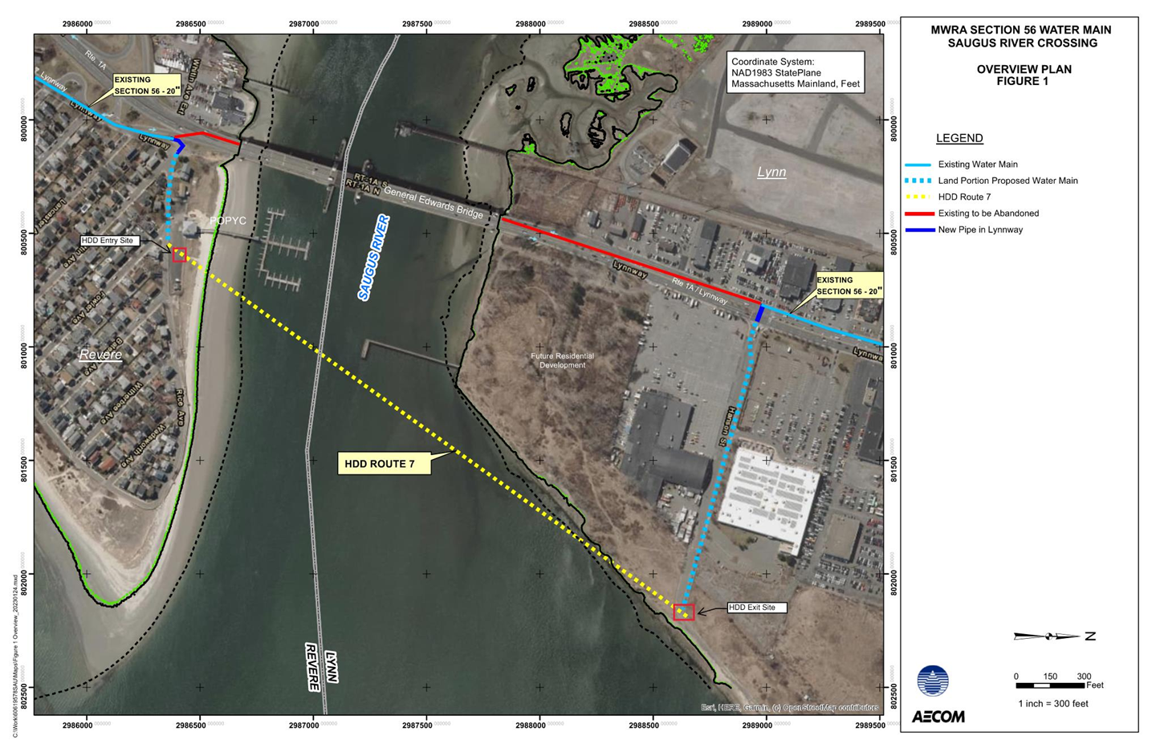
Project Overview
HDD Route from Hanson Street in Lynn to POPYC in Revere (yellow dotted line).

Slide 4
Project Work Schedule
  On Monday, September 15th work is expected to begin on Rice Avenue
  Work is expected to take approximately 8 to 10 weeks
  A Rice Avenue Detour will be in place during work hours
    The detour will be lifted during non-work hours (nights and weekends)
  Once completed, temporary roadway paving will be conducted
  Rice Ave hours of construction: 8:00AM-5:00PM; Monday through Friday
  On Monday, November 10th (or shortly thereafter) the contractor is expected to mobilize to the Point of Pines Yacht Club to prepare and start the HDD work
  Work is anticipated to be completed by March 2026
  In Spring 2026, Rice Avenue will be repaired (paving operations must wait approximately 90 days in order for the ground to settle)

Slide 5
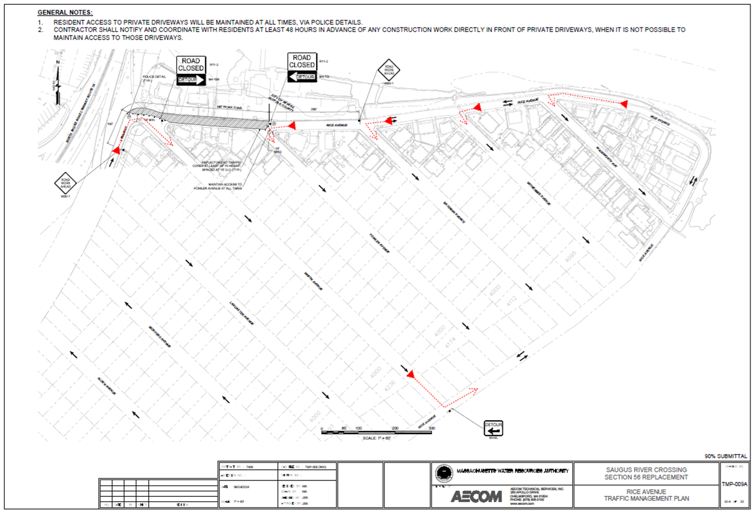
Detour Maps
Detour on Rice Avenue for the first part of the roadway work.

Slide 6
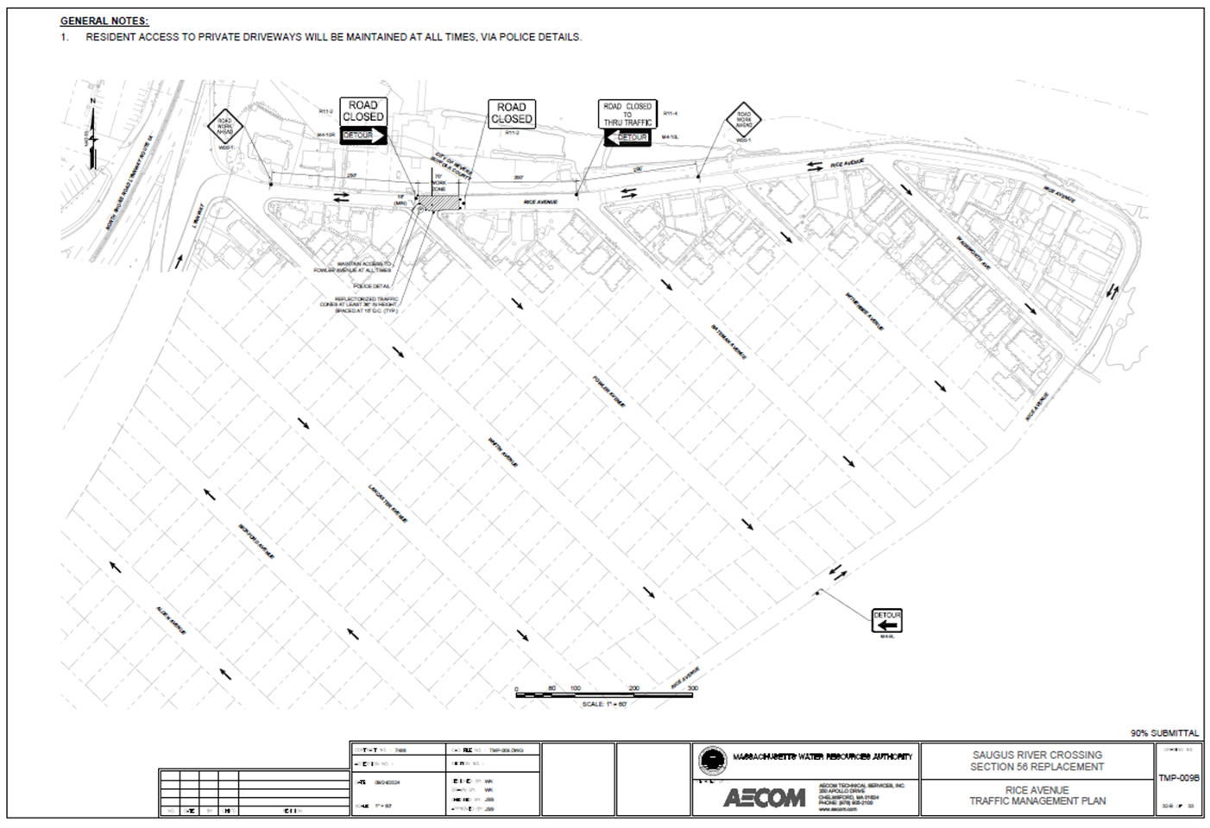
Detour Maps
Detour on Rice Avenue for the second part of the roadway work.

Slide 7
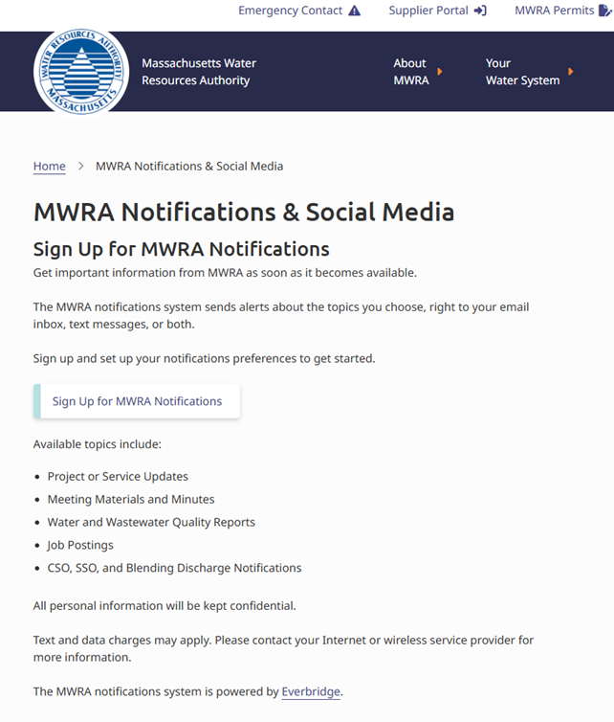
For More Information
Troy Wall: 617-305-5762 troy.wall@mwra.com
or
Visit the project page on www.mwra.com
or
Receive text and/or email notifications through the MWRA’s Everbridge system by visiting www.MWRA.com, then scrolling to the bottom of the page, and click “Follow Us”. Once there, visitors can “Sign Up for MWRA Notifications” and then choose the Lynn and Revere: Section 56 Saugus River project.

Slide 8
Questions
Any Questions?

